Slide 1

Project:
Renovation Works at Ricci Hall at 93 Pok Fu Lam Road
VIEW 3
VIEW 1
VIEW 4
VIEW 5
VIEW 2
C
Sub-basement Level
VIEW 6
PROGRESS PHOTO REPORT - 02
Date : 2014-8-14

Slide 2
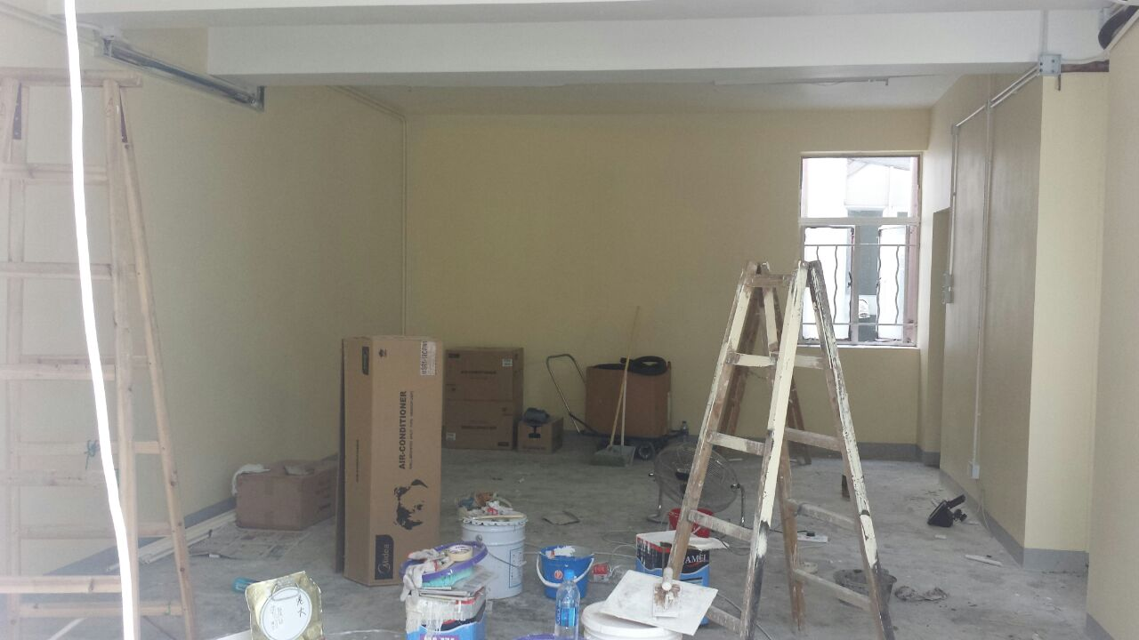
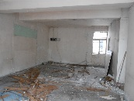
Descriptions
Paint to wall was completed
VIEW 1
2014-7-6
2014-8-14

Slide 3
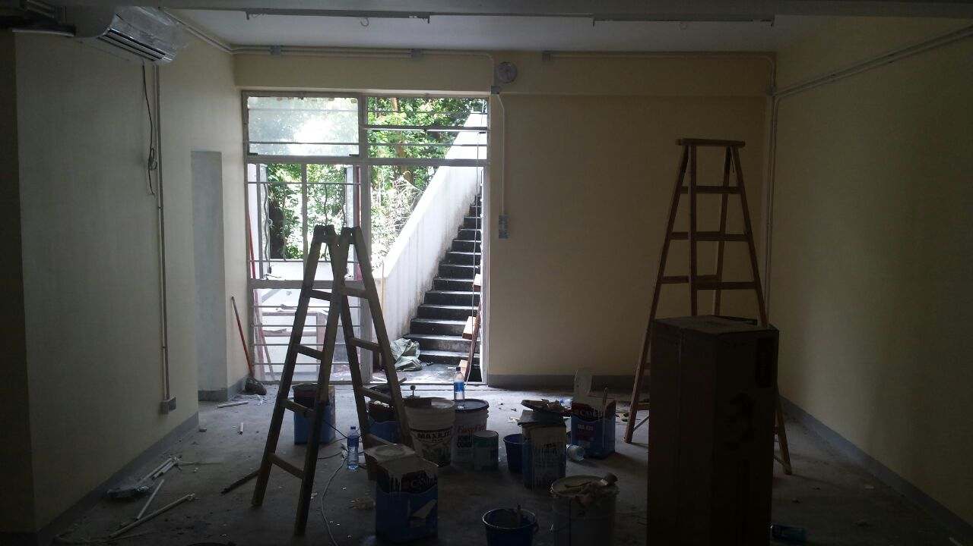
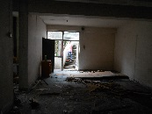
Descriptions
Paint to wall was completed
VIEW 2
2014-7-6
2014-8-14

Slide 4
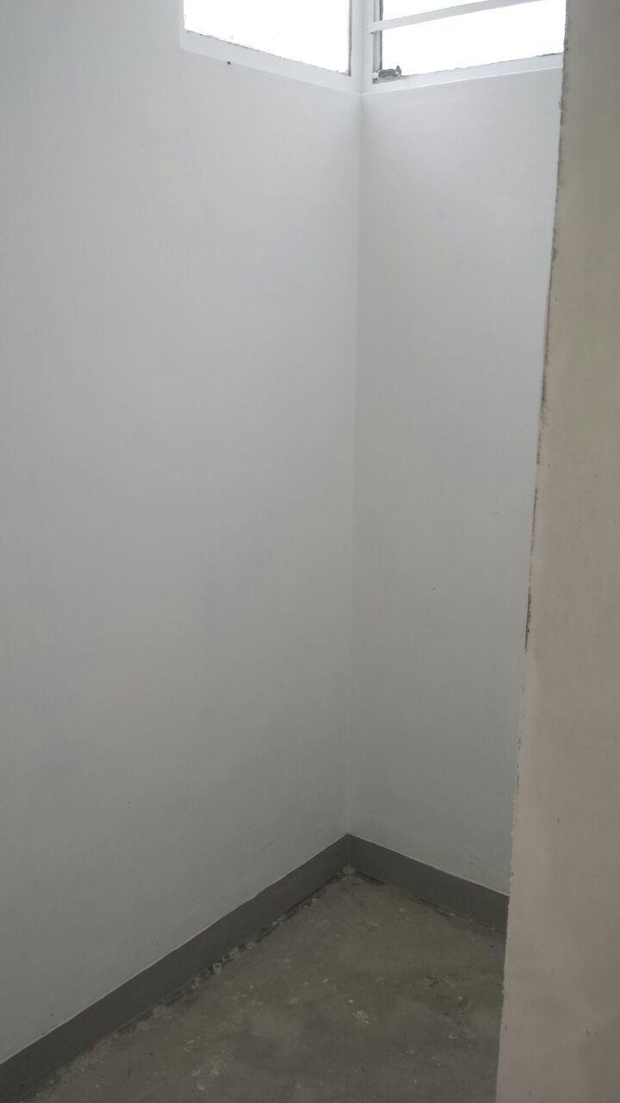
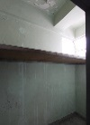
Descriptions
Paint to wall was completed
VIEW 3
2014-7-6
2014-8-14

Slide 5
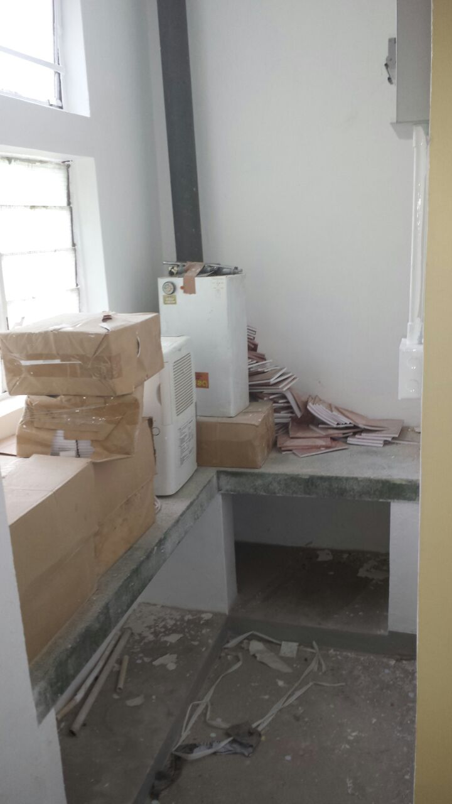
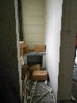
Descriptions
Paint to wall was completed
VIEW 4
2014-7-6
2014-8-14

Slide 6
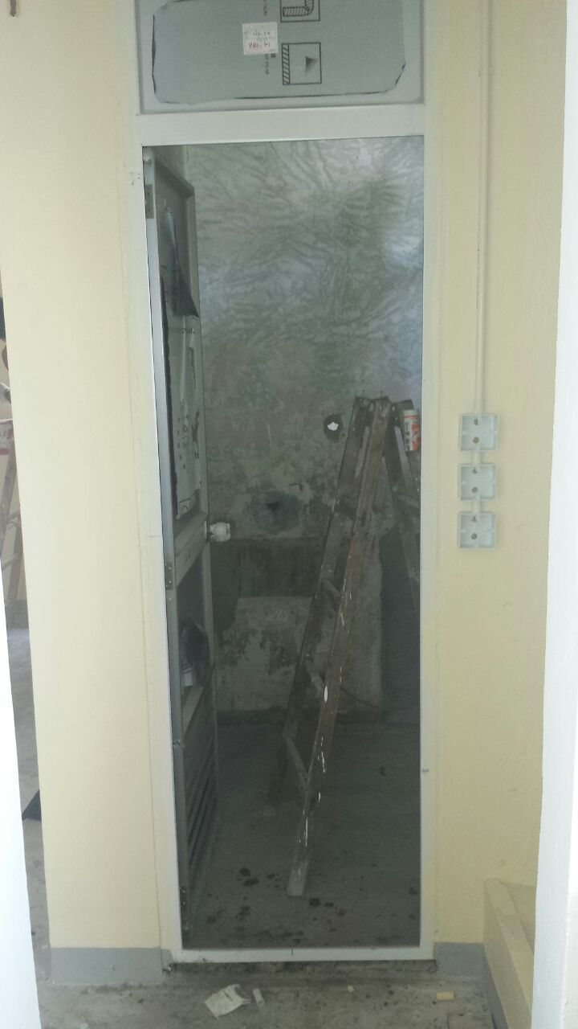
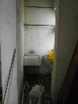
Descriptions
Site condition
VIEW 5
2014-7-6
2014-8-14

Slide 7
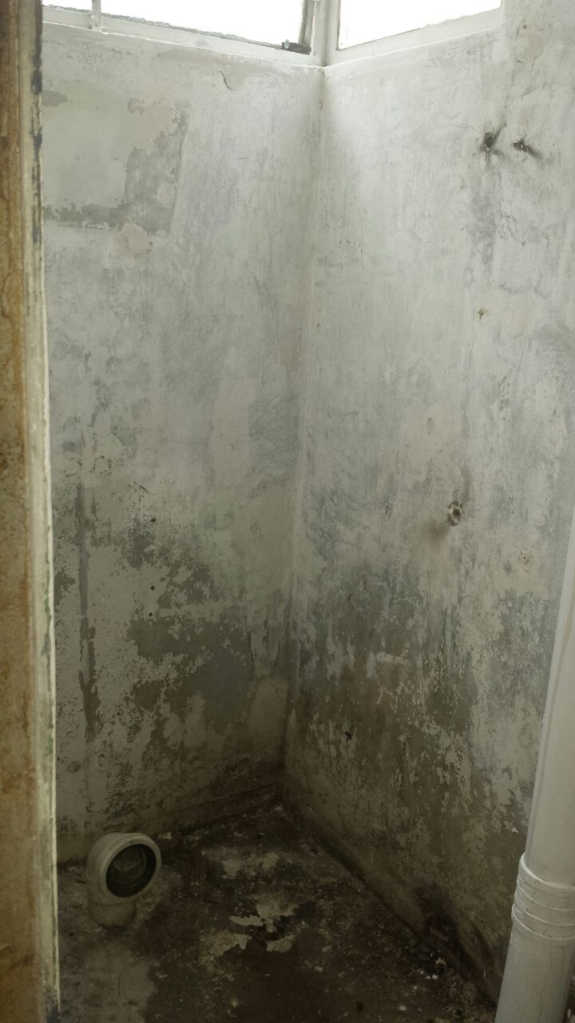
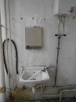
Descriptions
All the existing finish will be demolish
VIEW 6
2014-7-6
2014-8-14

Slide 8
Project:
Renovation Works at Ricci Hall at 93 Pok Fu Lam Road
VIEW 4
VIEW 2
VIEW 5
VIEW 6
VIEW 1
VIEW 7
C
Ground Floor
VIEW 8
VIEW 3
PROGRESS PHOTO REPORT - 02
Date : 2014-8-14

Slide 9
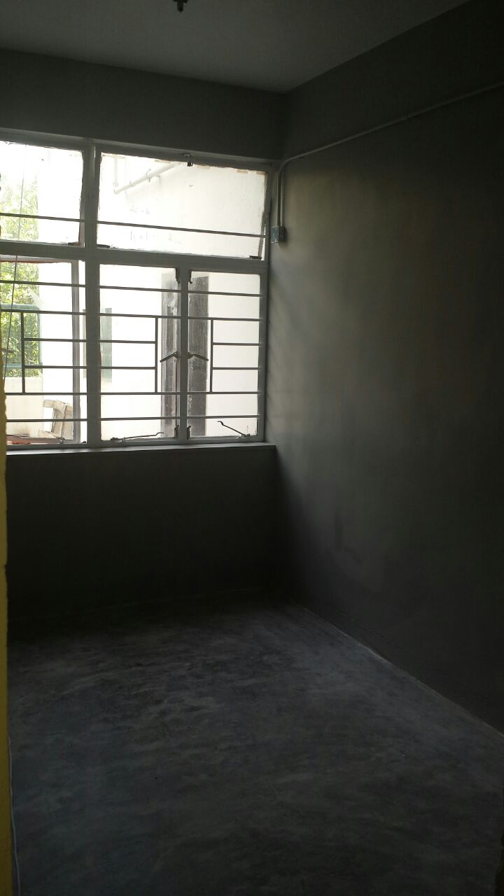
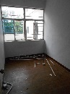
Descriptions
Paint to wall was completed
VIEW 1
2014-7-6
2014-8-14

Slide 10
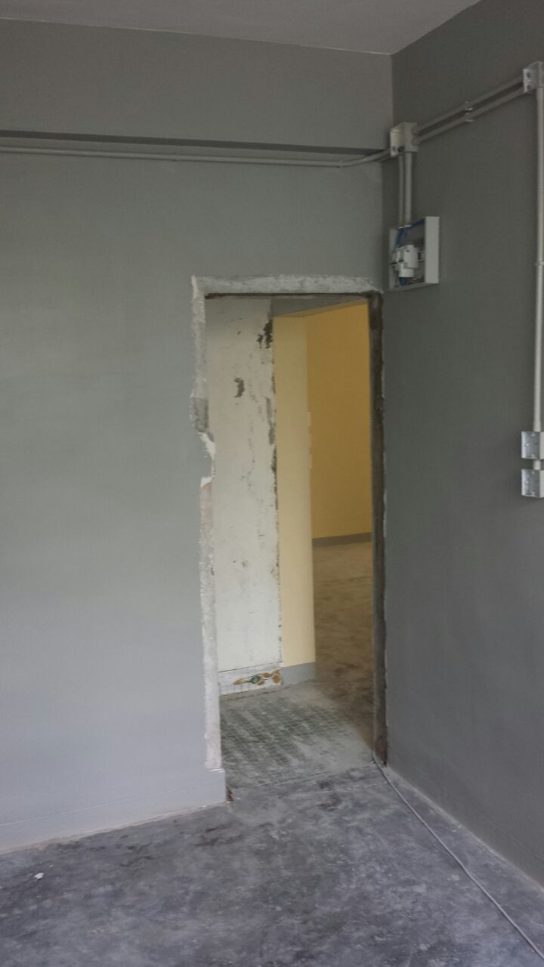
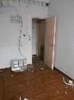
Descriptions
Paint to wall was completed
VIEW 2
2014-7-6
2014-8-14

Slide 11
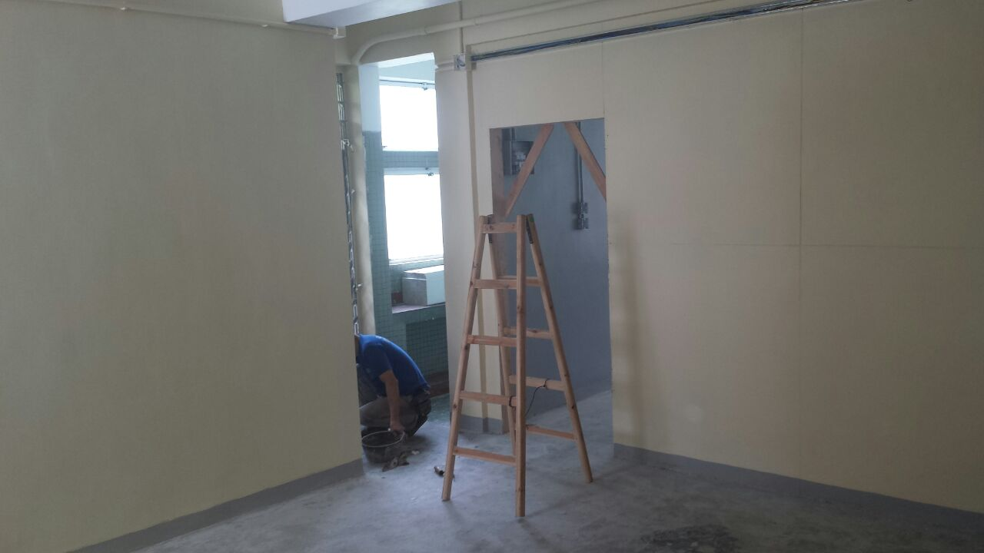
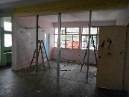
Descriptions
Paint to wall was completed
VIEW 3
2014-7-6
2014-8-14

Slide 12
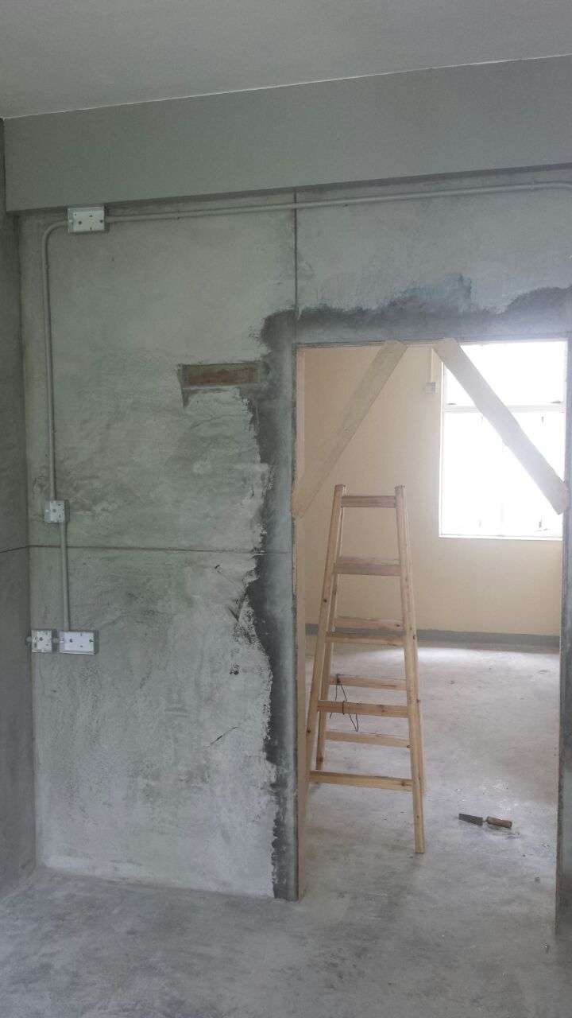
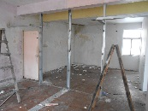
Descriptions
Plastering works in progress
VIEW 4
2014-7-6
2014-8-14

Slide 13
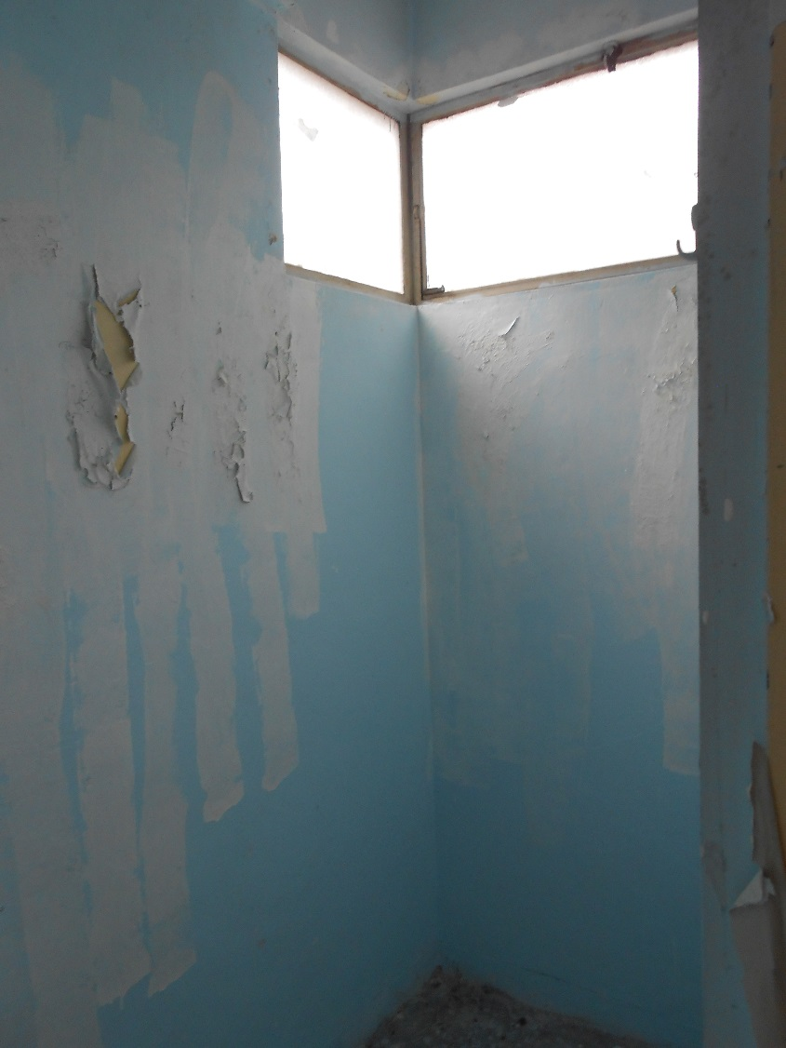

Descriptions
All the existing finish will be demolish
VIEW 5
2014-7-6
2014-8-14

Slide 14
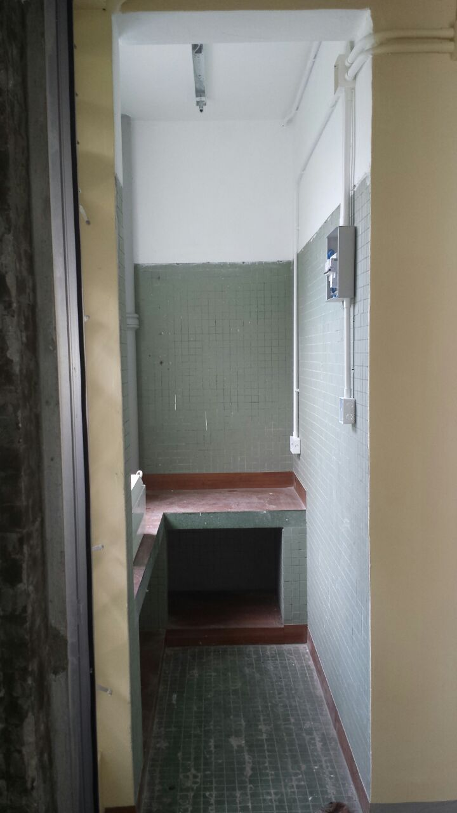
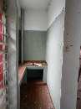
Descriptions
Paint to wall was completed
VIEW 6
2014-7-6
2014-8-14

Slide 15
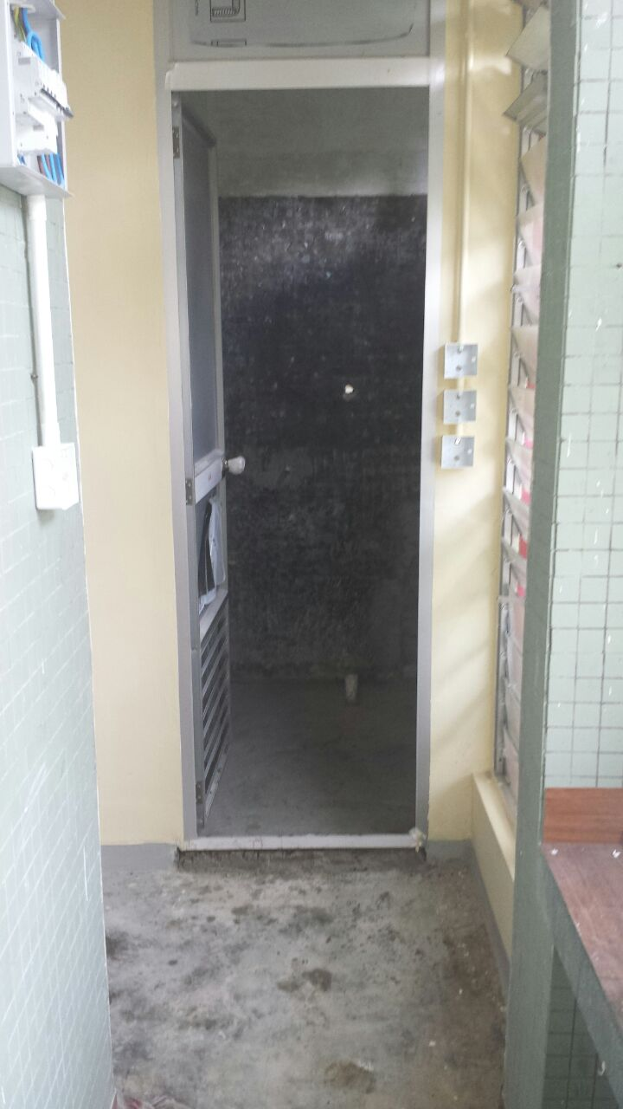
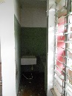
Descriptions
Site condition
VIEW 7
2014-7-6
2014-8-14

Slide 16
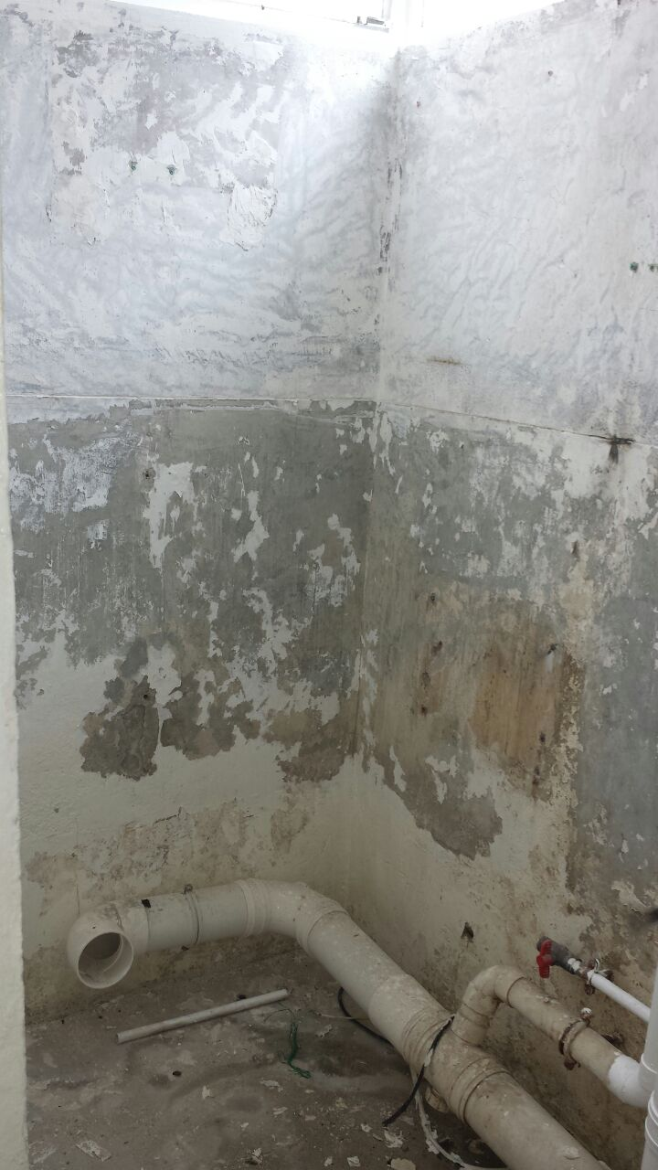
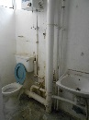
Descriptions
All the existing finish will be demolish
VIEW 8
2014-7-6
2014-8-14

Slide 17
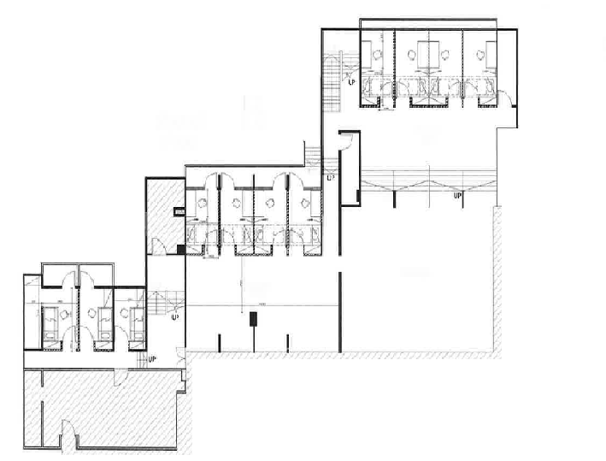
Project:
Renovation Works at Ricci Hall at 93 Pok Fu Lam Road
A
Ground Floor
VIEW 7
VIEW 5
VIEW 3
VIEW 9
B
Ground Floor
VIEW 10
VIEW 4
VIEW 8
VIEW 6
VIEW 7
VIEW 5
VIEW 3
VIEW 1
VIEW 1
VIEW 2
VIEW 2
VIEW 8
VIEW 6
VIEW 4
VIEW 14
VIEW 7
VIEW 6
VIEW 3
VIEW 1
VIEW 9
C
First Floor
VIEW 10
VIEW 13
VIEW 8
VIEW 2
VIEW 11
VIEW 12
VIEW 5
VIEW 4
PROGRESS PHOTO REPORT - 02
Date : 2014-8-14

Slide 18
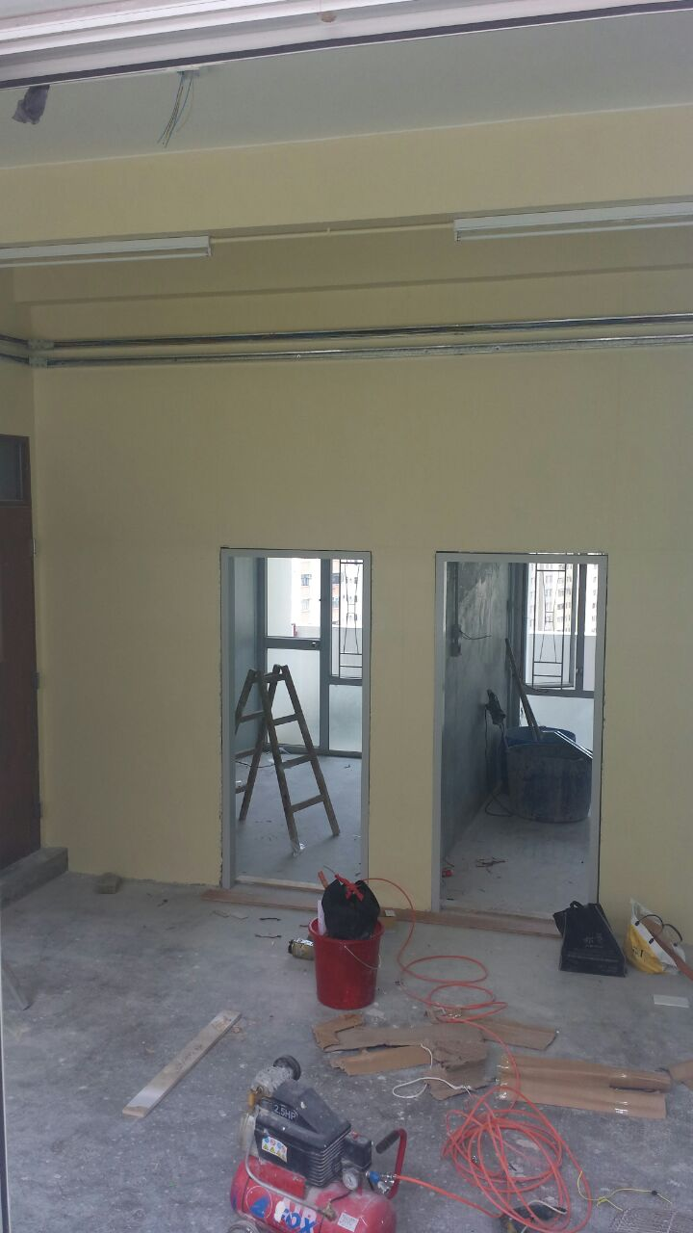
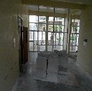
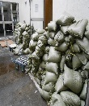
Descriptions
Paint to wall was completed
Brick wall work was finished
A
Ground Floor
VIEW 1
2014-7-6
2014-8-14

Slide 19
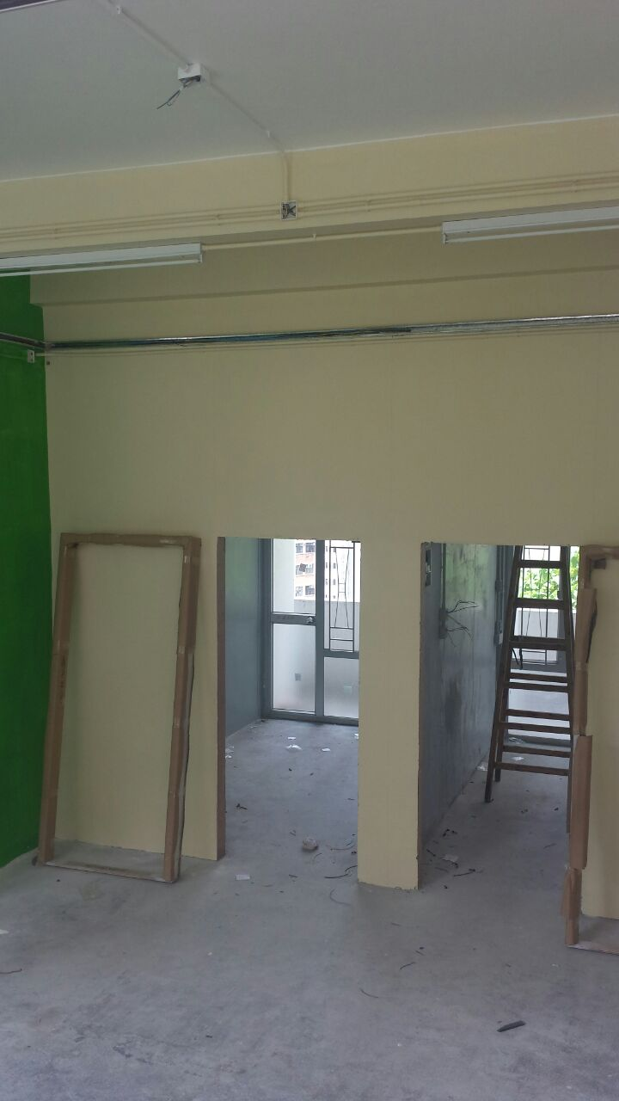
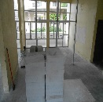
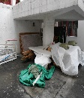
Descriptions
Paint to wall was completed
Brick wall work was finished
A
Ground Floor
VIEW 2
2014-7-6
2014-8-14

Slide 20
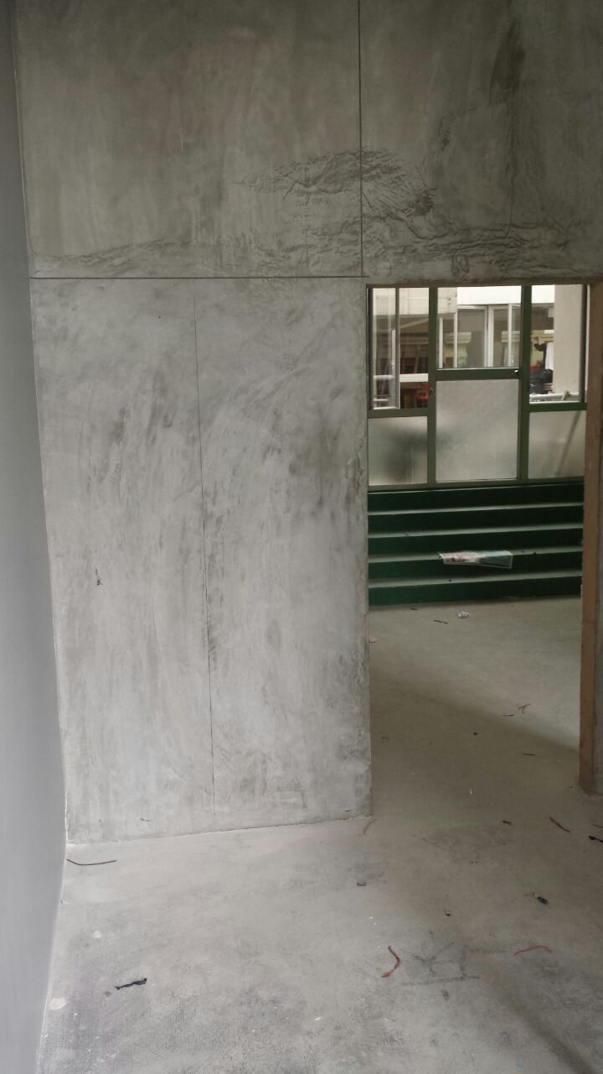
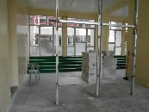
Descriptions
Plastering works in progress
A
Ground Floor
VIEW 3
2014-7-6
2014-8-14

Slide 21
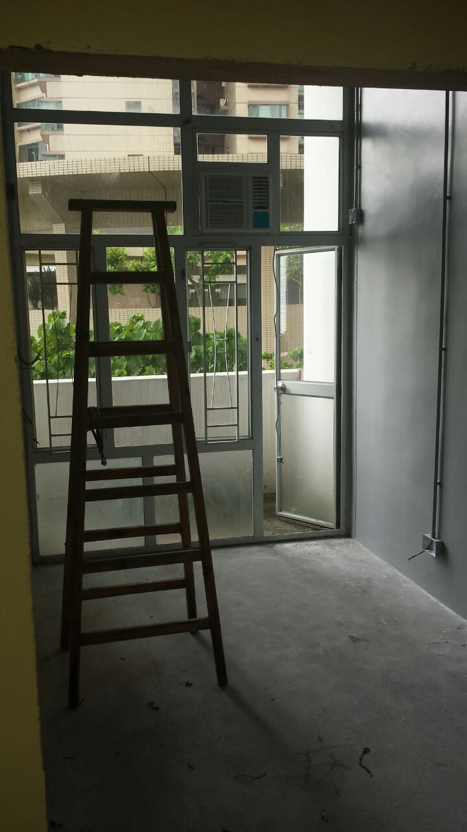
Descriptions
Paint to wall was completed
A
Ground Floor
VIEW 4
2014-7-6
2014-8-14

Slide 22
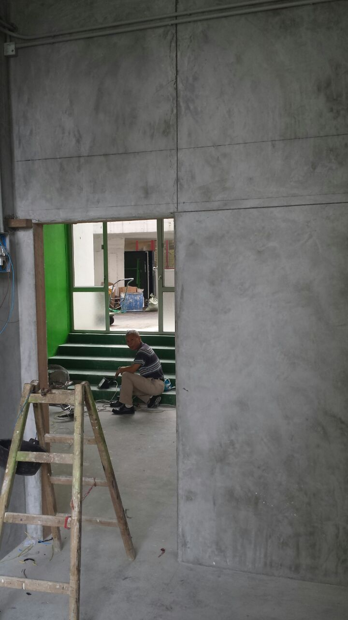
Descriptions
Plastering works in progress
A
Ground Floor
VIEW 5
2014-7-6
2014-8-14

Slide 23
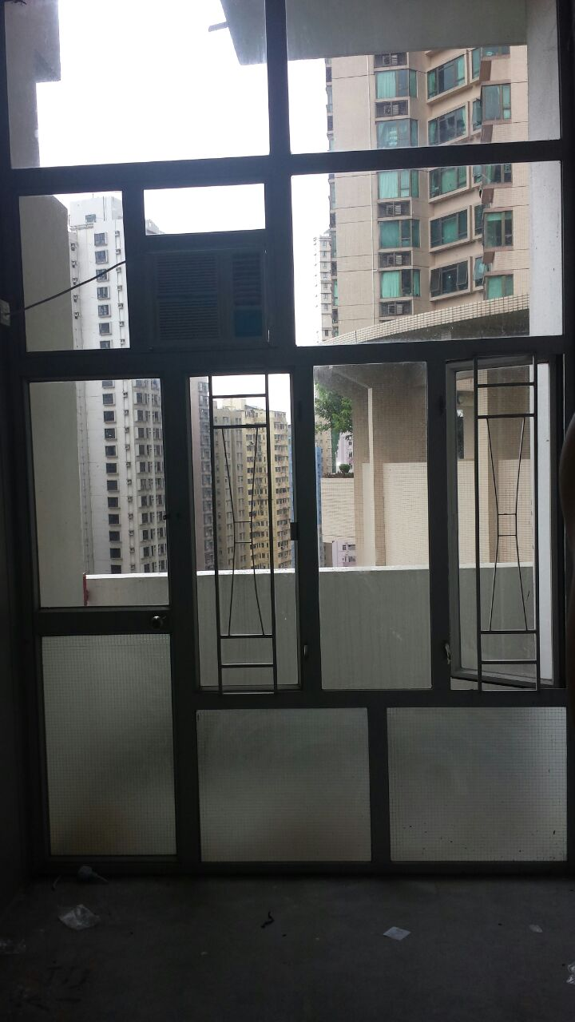
Descriptions
Site condition
A
Ground Floor
VIEW 6
2014-7-6
2014-8-14

Slide 24
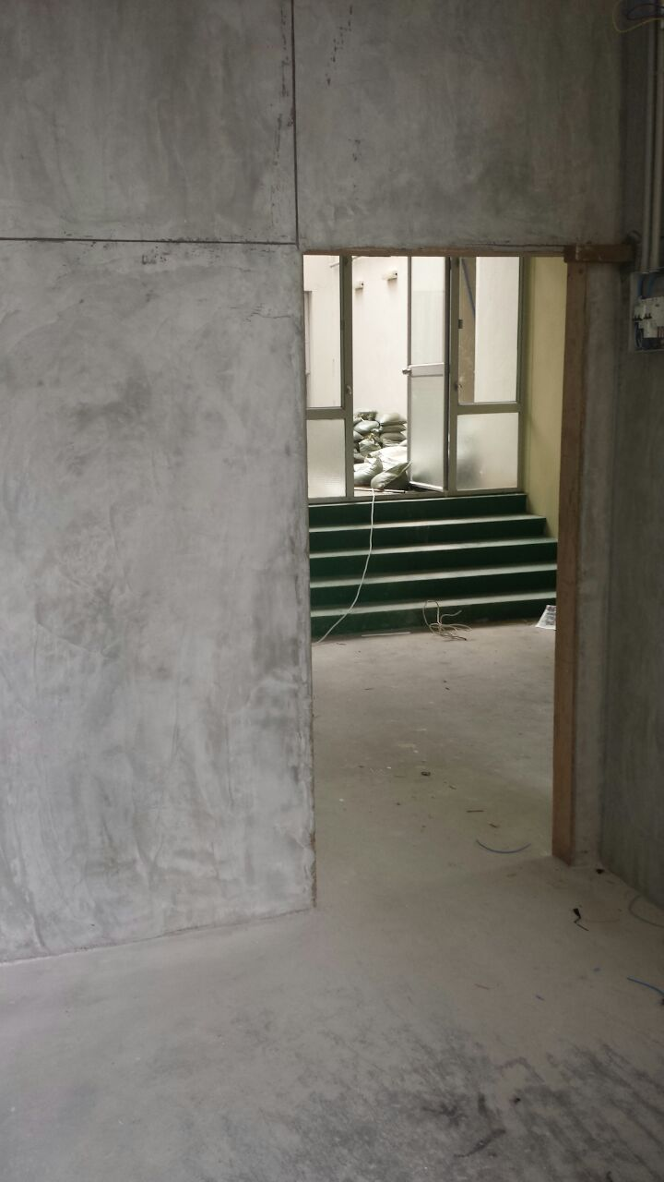
Descriptions
Plastering works in progress
Sand arrived on site
A
Ground Floor
VIEW 7
2014-7-6
2014-8-14

Slide 25
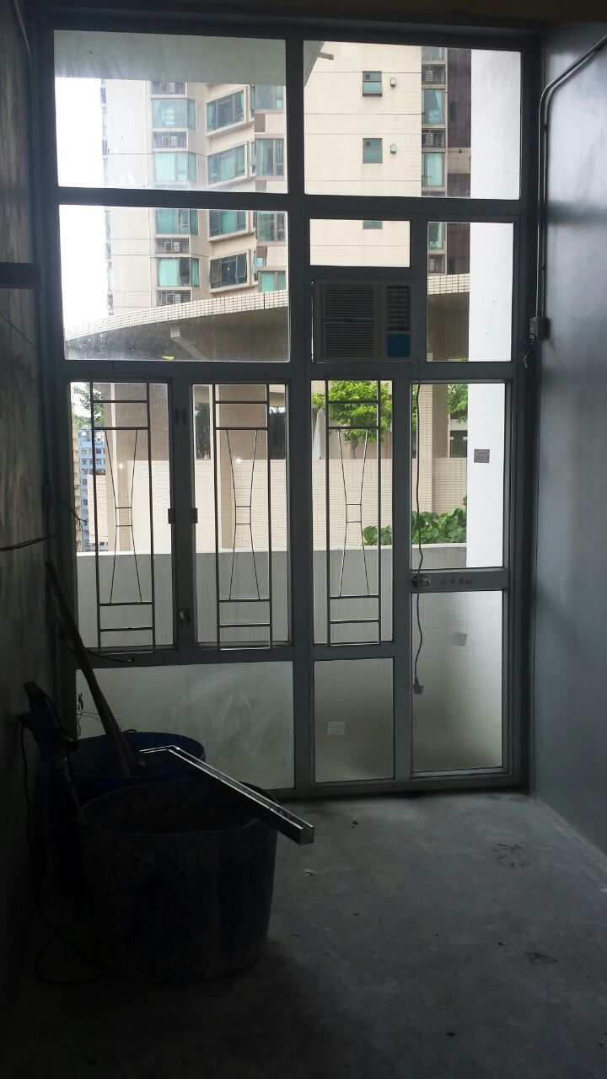
Descriptions
Plastering works in progress
A
Ground Floor
VIEW 8
2014-7-6
2014-8-14

Slide 26
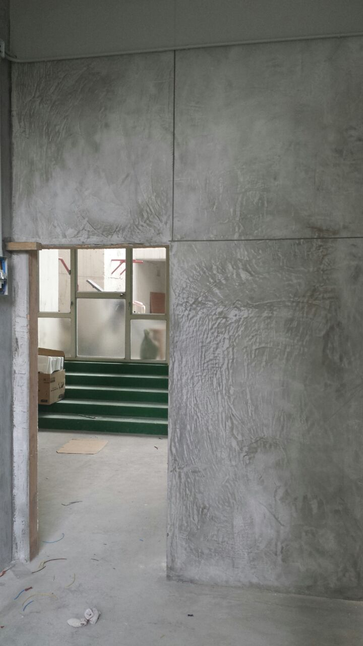
Descriptions
Plastering works in progress
A
Ground Floor
VIEW 9
2014-7-6
2014-8-14

Slide 27
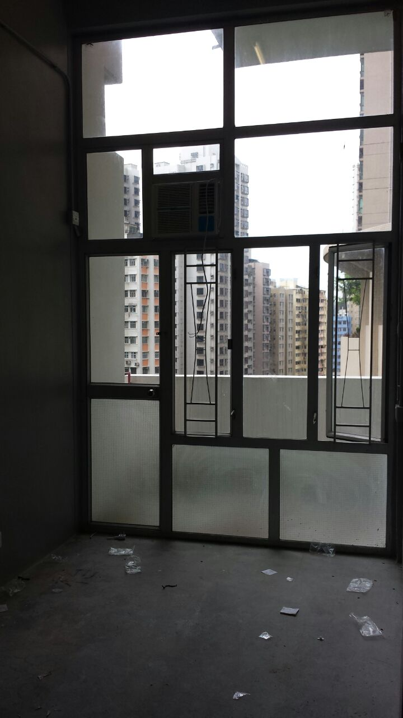
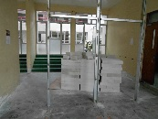
Descriptions
Site condition
A
Ground Floor
VIEW 10
2014-7-6
2014-8-14

Slide 28
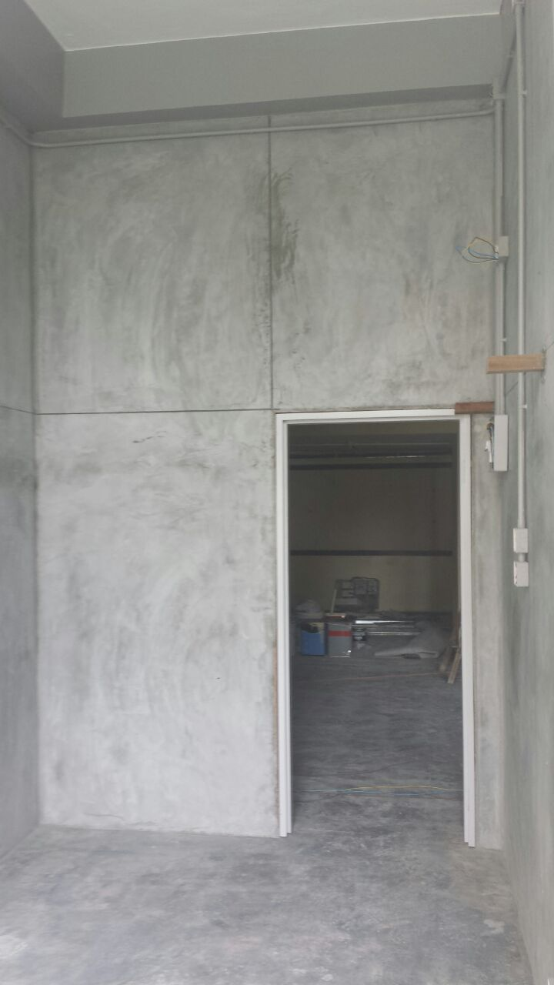
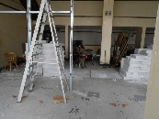
Descriptions
Plastering works in progress
B
Ground Floor
VIEW 1
2014-7-6
2014-8-14

Slide 29
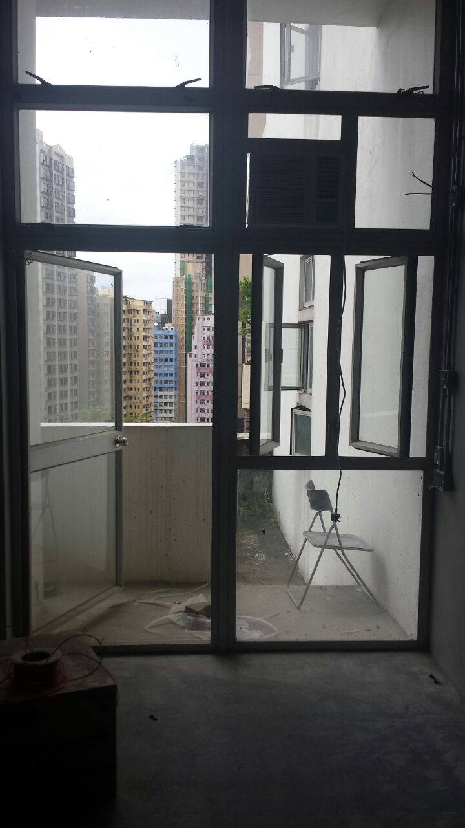
Descriptions
Site condition
B
Ground Floor
VIEW 2
2014-7-6
2014-8-14

Slide 30
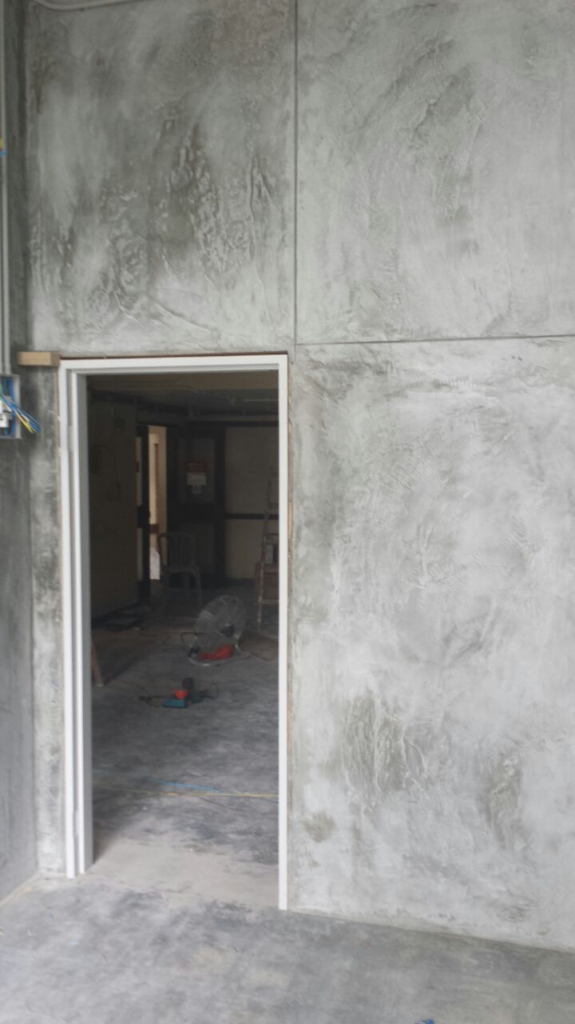
Descriptions
Plastering works in progress
B
Ground Floor
VIEW 3
2014-7-6
2014-8-14

Slide 31
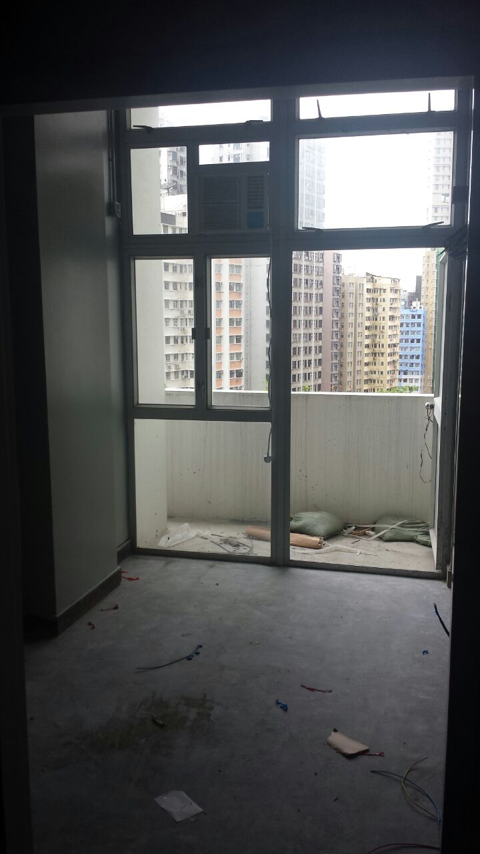
Descriptions
Paint to wall was completed
B
Ground Floor
VIEW 4
2014-7-6
2014-8-14

Slide 32
Descriptions
Plastering works in progress
B
Ground Floor
VIEW 5
2014-7-6
2014-8-14

Slide 33
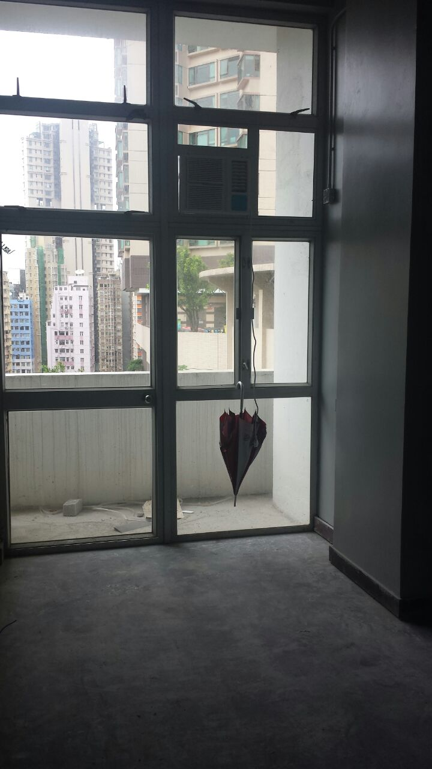
Descriptions
Paint to wall was completed
B
Ground Floor
VIEW 6
2014-7-6
2014-8-14

Slide 34


Descriptions
Plastering works in progress
B
Ground Floor
VIEW 7
2014-7-6
2014-8-14

Slide 35

Descriptions
Site condition
B
Ground Floor
VIEW 8
2014-7-6
2014-8-14

Slide 36


Descriptions
Paint to wall was completed
Brick wall work was finished
B
Ground Floor
VIEW 9
2014-7-6
2014-8-14

Slide 37


Descriptions
Paint to wall was completed
Brick wall work was finished
B
Ground Floor
VIEW 10
2014-7-6
2014-8-14

Slide 38


Descriptions
All the existing finish will be demolish
Site material arrived on site
B
Ground Floor
VIEW 11
2014-7-6
2014-8-14

Slide 39


Descriptions
All the existing finish will be demolish
Site material arrived on site
B
Ground Floor
VIEW 12
2014-7-6
2014-8-14

Slide 40


Descriptions
Paint to wall was completed
B
Ground Floor
VIEW 13
2014-7-6
2014-8-14

Slide 41


Descriptions
All the existing finish will be demolish
B
Ground Floor
VIEW 14
2014-7-6
2014-8-14

Slide 42

Descriptions
Plastering works in progress
C
Ground Floor
VIEW 1
2014-7-6
2014-8-14

Slide 43

Descriptions
Plastering works in progress
C
Ground Floor
VIEW 2
2014-7-6
2014-8-14

Slide 44

Descriptions
Plastering works in progress
The door frame has installed
C
Ground Floor
VIEW 3
2014-7-6
2014-8-14

Slide 45

Descriptions
Plastering works in progress
C
Ground Floor
VIEW 4
2014-7-6
2014-8-14

Slide 46

Descriptions
Paint to wall was completed
C
Ground Floor
VIEW 5
2014-7-6
2014-8-14

Slide 47

Descriptions
Plastering works in progress
C
Ground Floor
VIEW 6
2014-7-6
2014-8--14

Slide 48

Descriptions
Paint to wall was completed
C
Ground Floor
VIEW 7
2014-7-6
2014-8-14

Slide 49

Descriptions
Paint to wall was completed
C
Ground Floor
VIEW 8
2014-7-6
2014-8-14

Slide 50
Project:
Renovation Works at Ricci Hall at 93 Pok Fu Lam Road
B
First Floor
E
First Floor
E
First Floor
VIEW 2
VIEW 3
VIEW 1
VIEW 1
VIEW 1
VIEW 2
VIEW 2
PROGRESS PHOTO REPORT - 02
Date : 2014-8-14

Slide 51


Descriptions
Plastering works in progress
B
First Floor
VIEW 1
2014-7-6
2014-8-14

Slide 52


Descriptions
Plastering works in progress
B
First Floor
VIEW 2
2014-7-6
2014-8-14

Slide 53


Descriptions
Plastering works in progress
B
First Floor
VIEW 4
2014-7-6
2014-8-14

Slide 54


Descriptions
Plastering works in progress
E
First Floor
Female Toilet & Disable toilet
VIEW 1
2014-7-6
2014-8-14

Slide 55


Descriptions
Plastering works in progress
E
First Floor
Female Toilet & Disable toilet
VIEW 2
2014-7-6
2014-8-14

Slide 56


Descriptions
Plastering works in progress
E
First Floor
Male Toilet
VIEW 1
2014-7-6
2014-8-14

Slide 57


Descriptions
Plastering works in progress
E
First Floor
Male Toilet
VIEW 2
2014-7-6
2014-8-14

